Slide 1
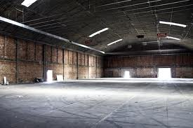
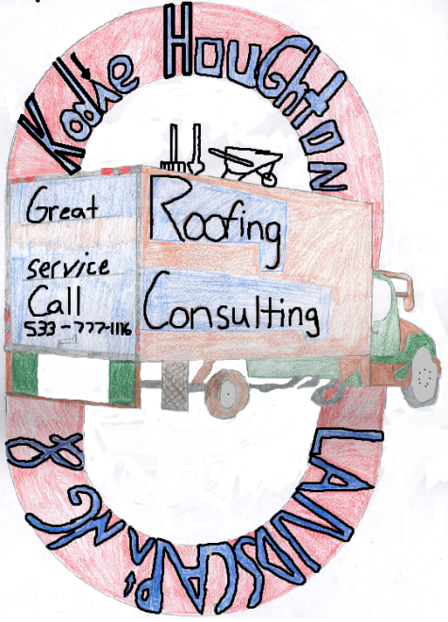
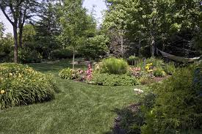
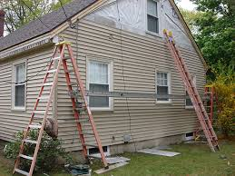
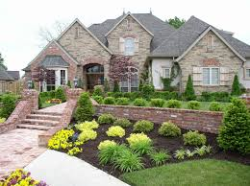
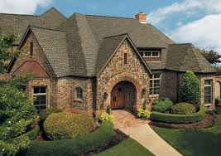
Kodie Houghton Landscaping
& Roofing Consulting.
Located at the corner of State Road 3 and Windbreaker Lane.
Service
We follow storm damage and replace the roofs and siding. We do roofs through out the Midwest .
We do landscaping jobs only in Indiana.
Contact us at.
Phone. 533-333-3330
Quality work at the best.
Here for the customer, For the customer, work for the customer.

